Slide 1
APPLICATIONS of HIGH ENERGY PHYSICS
–( R&D, IDEAS, TECH )– .: mainly particle accelerators and detectors :.
R. Mountain
Syracuse University

Slide 2
Overview
Applications of High Energy Physics
Particle physics is a basic science (no direct applications), but…
There is a great deal of:
R&D (needed to build accelerators and detectors for HEP),
Ideas and concepts generated (incl. theoretical), and
Practical technological developments
Will consider these as applied to other fields and disciplines
Beyond the technology, what is unique to particle physics is the scale of the science: its size and complexity. Dealing with scale issues is also exportable to other fields
Near Fields — (other) physics, astronomy, geology, …
Far Fields — medicine, electronics, computing, …
Really Far Fields — energy, defense, industry, …
Take a random walk through some of these other fields…

Slide 3
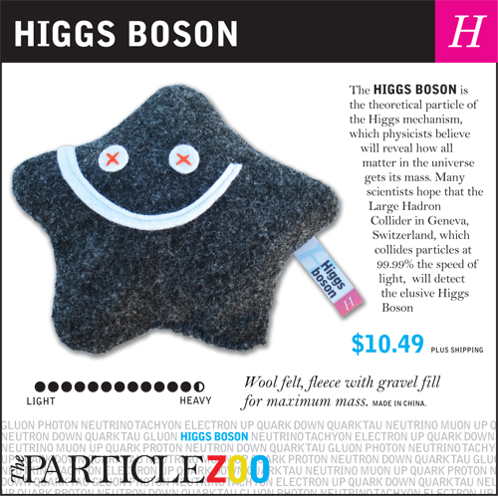
No Higgs Today!

Slide 4
APPLICATIONS IN CONDENSED MATTER physics
Part I.
Material Structure

Slide 5
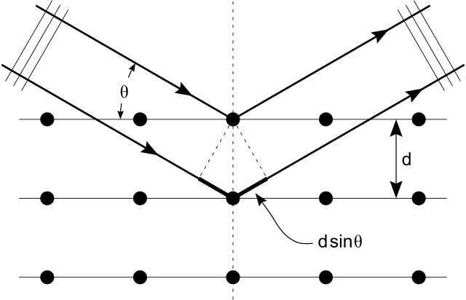
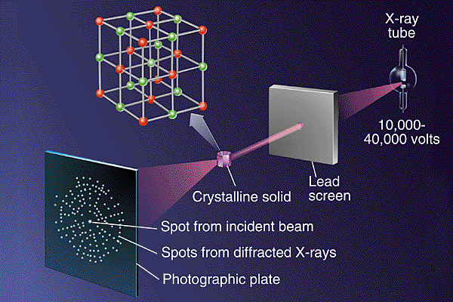
Material Structure with SLS
Origin
Synchrotron radiation: GE, 1946
SLS: ~1980s
Technique
Use synchrotron light source (SLS = dedicated accelerator)
Crystallography: X-ray diffraction technique
Physics
Interference pattern made by transmission or reflection of x-rays from a crystal (Bragg scattering)
Also by x-ray fluorescence (like scintillator but excitation by x-rays)
Examine diffraction pattern
Reconstruct crystal structure: atomic locations, electron orbital densities, etc.
Computationally model crystal structure of material

Slide 6
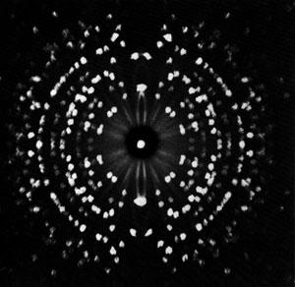
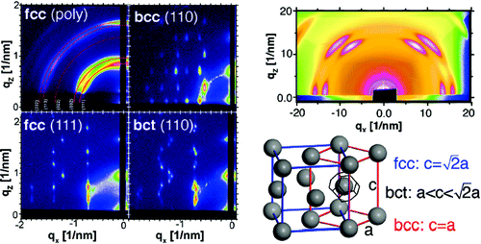
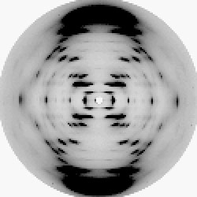
Crystallographic Patterns
X-ray diffraction pattern, single aluminum crystal,
H.J. Milledge, University College, London
X-ray diffraction patterns,
nano-crystal lattices,
www.chess.cornell.edu
DNA structure, 1950s

Slide 7
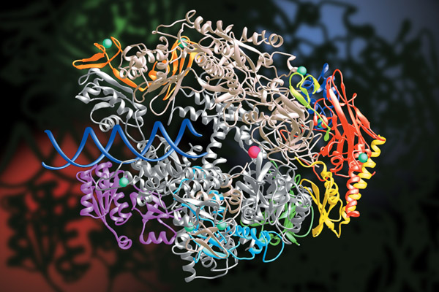
Crystallographic Patterns
protein crystallography:
RNA polymerase,
30,000 individual atoms

Slide 8
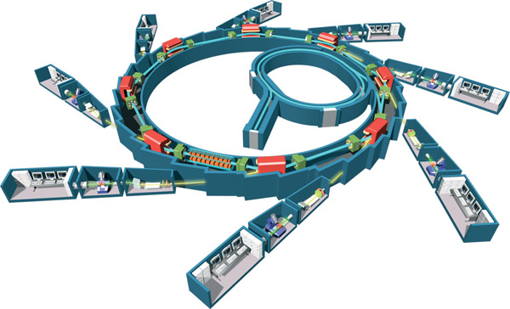
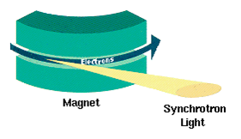
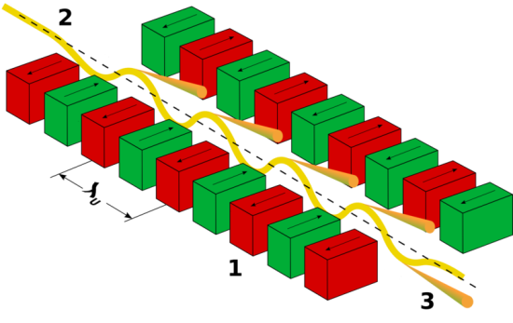
Synchrotron Light Sources
Accelerator Facilities
Dozen facilities worldwide
NSLS Brookhaven, SSRL Stanford, ALS Berkeley, APS Argonne, CHESS Cornell …
Multi-disciplinary research
physics, chemistry, biology, materials science, environmental science, art
Using HEP accelerator tech to study structure and function
Synchrotron Radiation
Photons generated by acceleration of e–,p beam (bend, wiggler magnets)
do this on purpose!
Broad energy spectrum (tunable)
High intensity on target
SOLEIL, France
NSLS, BNL
bending
wigglers

Slide 9
MEDICAL APPLICATIONS
Part II.
Medical Imaging
Clinical Treatments (e.g. Oncological)

Slide 10
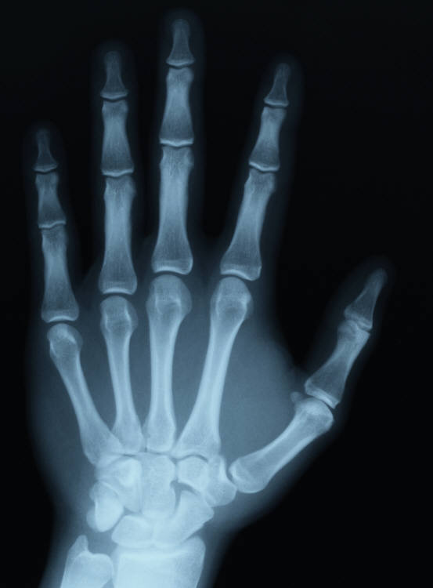
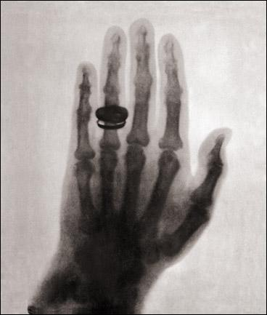
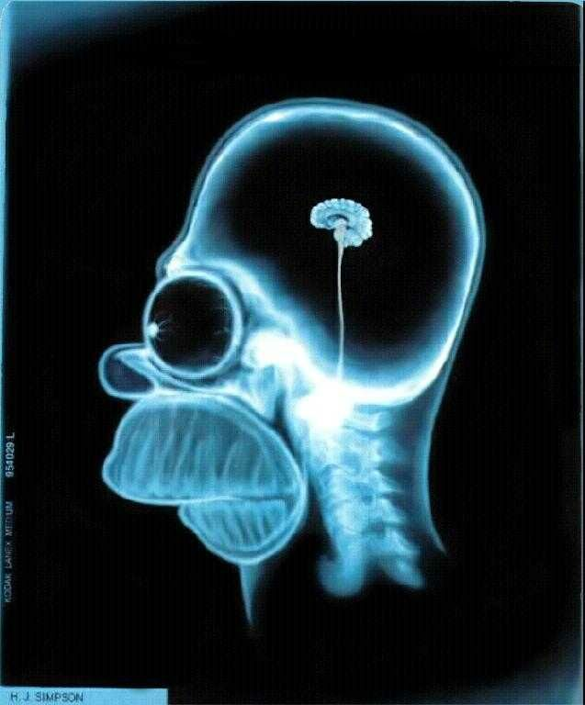
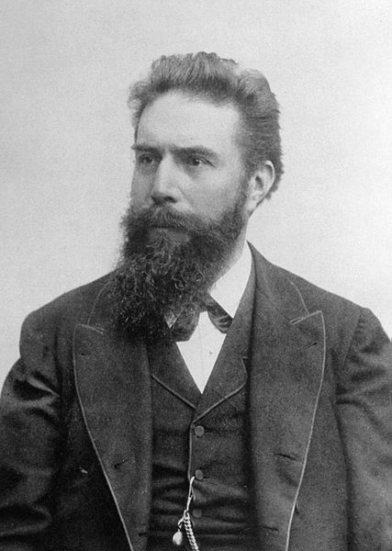
X-Rays
Origins
Wilhelm Conrad Roentgen, 1895
First Nobel Prize, 1901 (detector)
Technique
Imaging: use x-rays to shadow object, create latent image on photographic film, or energy pattern on CCD camera
Therapeutic: use x-ray beam to deposit energy in object (e.g. cancer cells)
Physics
X-rays penetrate object, pass through with some amount of attenuation (either small or large, depends on Z)
Small: passes through, transmitted, can be used to create an image (imaging)
Large: deposits energy, locally heats object (therapeutic, “conventional” radiotherapy)
Behavior is similar for all photons (X, Gamma, UV, VIS, …)
Advantages
Relatively simple
Depends on Z
Roentgen’s wife
(first x-ray image)
Modern x-ray
image

Slide 11
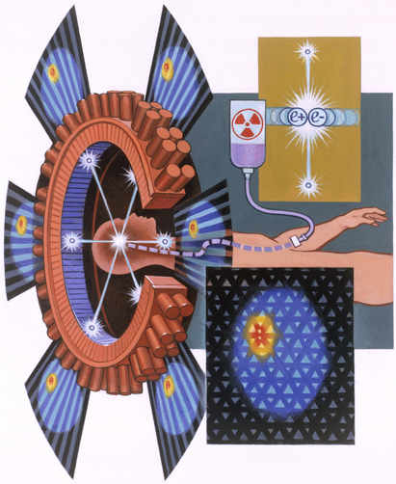
Positron Emission Tomography (PET)
Origins
1960s
Technique
Imaging device, 2D or 3D
Use radionuclide tracer technique (tracer = biochemical agent which bonds with target cancer cells, e.g. ¹⁸F-FDG)
Physics
Radionuclide decays, emitting β⁺
β⁺ annihilates with e– from tissue, forms back-to-back 0.511 MeV gamma pair
Gamma pairs are detected using PMT + crystal scintillators in a ring arrangement
Analysis
Make time coincidence (∆t < 6–12 ns) between any pair of these detectors
Each detector pair defines a line
Reconstruct position of radiotracer by intersection of all such lines
Can add TOF (time-of-flight) info to reduce noise, correct ions for attenuation, scattering, noise, etc.
Positron Annihilation
Positron travels short distance in tissue
in tracer
Davis Meltzer, National Geographic
From J. Karp, Positron Emission Tomography, Fermilab colloquium, 2004

Slide 12
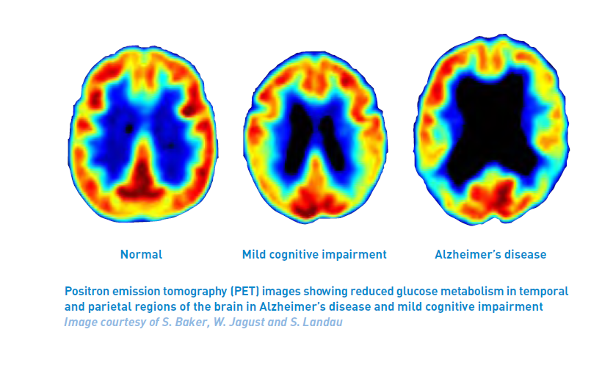
PET Images
(FDG)

Slide 13
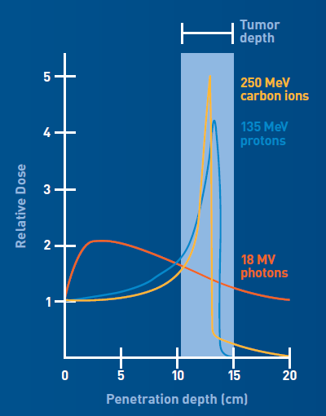
Proton Therapy (PT)
Origin
Developed by: Robert Wilson, Harvard, 1946
Purpose: Cancer treatment
Technique
Cyclotron (accelerator)
Accelerate protons to low energies, KE≈200 MeV
Shoot proton beam at patient: head, body, extremity
Physics
Protons penetrate the body, deposit energy along path, until it has lost enough and then stops in the body
Bragg curve: deposits most of energy at end of its path, called “ranging out”
Calculate energy needed for proton to reach target tumor (range) and it will deposit most of its energy into the tumor only, and only a small amount into intermediate tissue
Clinical
Operation: energy heats cancer cells
impeding cell division, plus
damaging cells, increasing probability of cell death
Advantages
Differs from conventional (x-ray) radiation therapy:
Proton is a “depth charge” as used in PT
Gamma-rays are like a penetrating laser, damaging tissue on straight line, before/after/in tumor
Facilities: 12 in USA, ~6 online soon

Slide 14
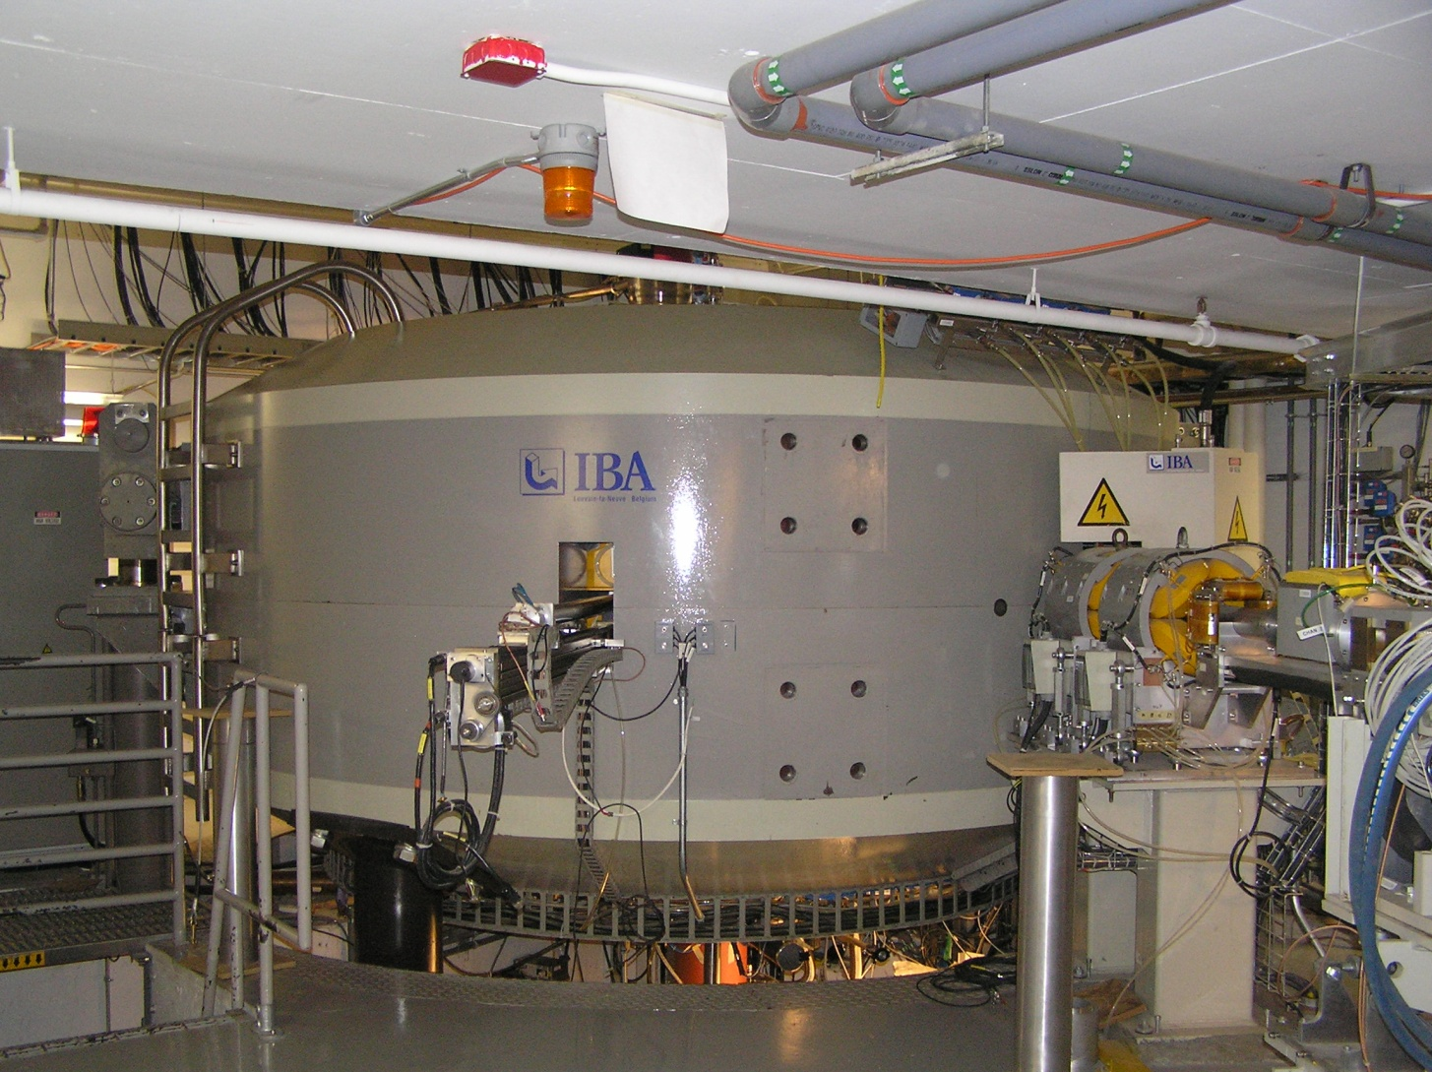
NPTC @ MGH — Cyclotron
Northeast Proton Therapy Facility @ Mass General Hospital, Boston MA
Louvain #00

Slide 15
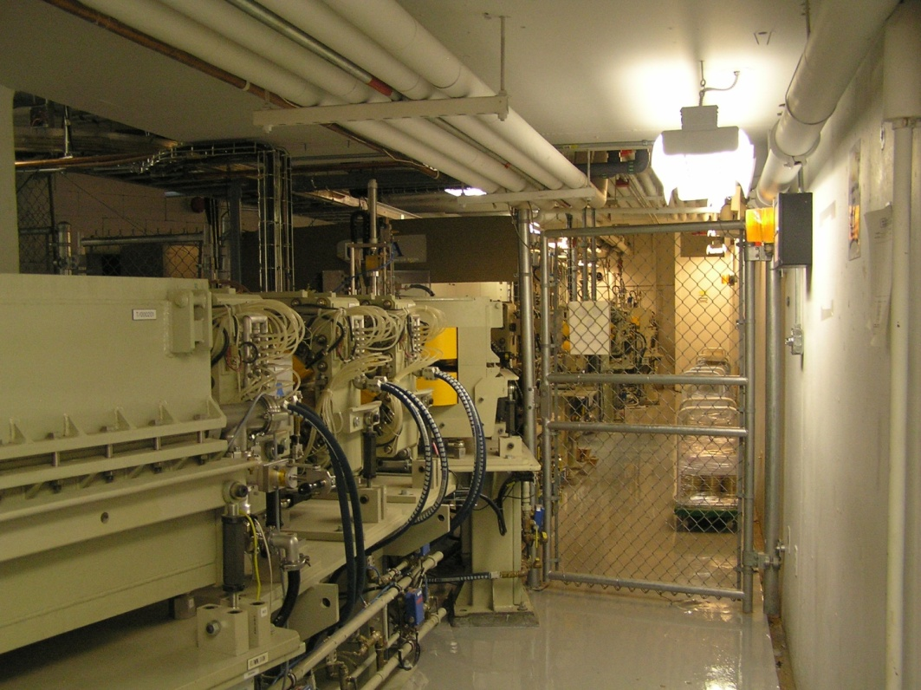
NPTC @ MGH — Beamline
Beam Line
Extraction Line

Slide 16
NPTC @ MGH — Patient Area
Aperture
230 MeV protons
Arm
(rotates)
Patient
Gantry

Slide 17
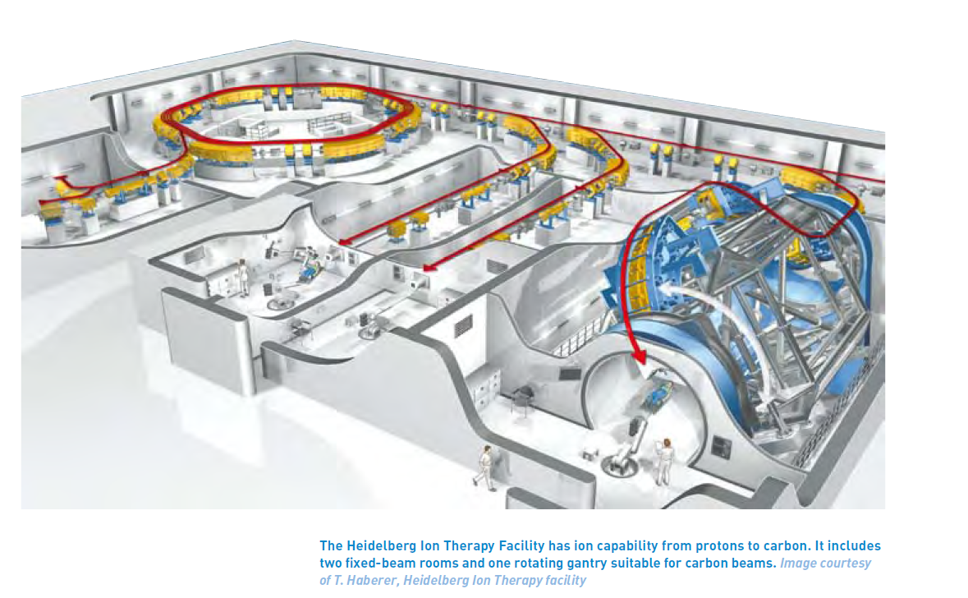
Heidelberg Therapy Facility
acceleratorsamerica.org

Slide 18
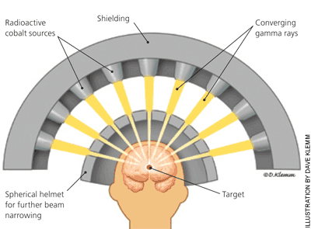
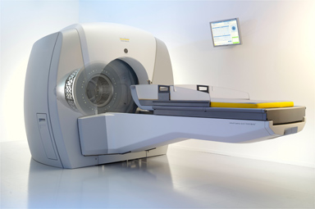
Gamma Knife
Origins
L. Leksell, Stockholm, 1951
Cyberknife, 1994 (feedback)
Technique
Uses intense radioactive sources: ⁶⁰Co gamma-rays
Purpose: non-invasive treatment of brain tumors
Physics
Collimating of gamma-rays into many precision beams
Relies on intensity superposition of gamma-ray beams
Clinical
Similar to conventional radiation therapy, with same drawbacks
Facilitates treatment of small targets deep within the brain
Upstate Gamma Knife Center

Slide 19
Applications to archaeology
Part III.
Muon Tomography

Slide 20
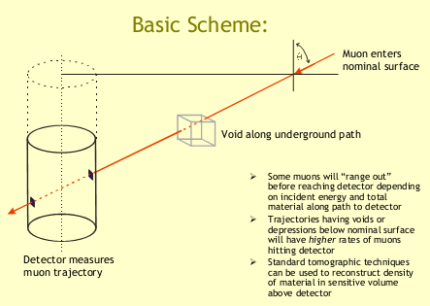
Muon Tomography
Origin
Luis Alvarez, 1968
Imaged Khefe Pyramid (2nd Giza), in search of… hidden chambers
Technique
Uses cosmic rays
Uses directional detectors in a large array
Physics
Passing muons are preferentially absorbed by denser material
Scattering dominates resolution
Map flux in a given direction
Reconstruction of density in 3D using standard computational tomography
From: Schwitters, Imaging Maya Pyramids with Cosmic Ray Muons, 2008

Slide 21
Security / defense applications
Part IV.
MST
Backscatter

Slide 22
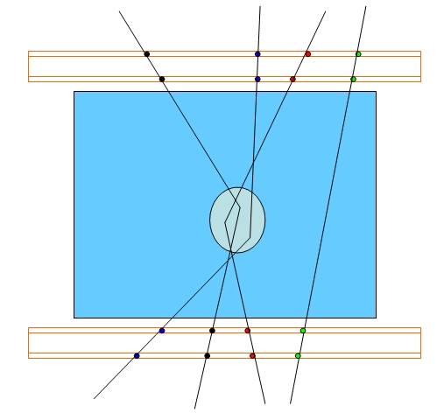
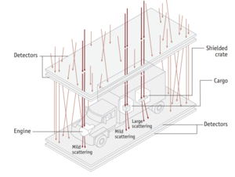
Muon Scatter Tomography
Technique
Similar to muon tomography but uses scattered muons instead of straight-throughs
Use tracking detectors like drift chambers, to get direction of muon
Non-invasive
Physics
Coulomb (EM) scattering
Scattering goes like density: denser, high-Z materials scatter more
Use timing to see muons that scatter and reconstruct to the scattering point
Applications
Large size objects
Cargo containers , trucks, etc.
Hidden nukes under layers of steel

Slide 23
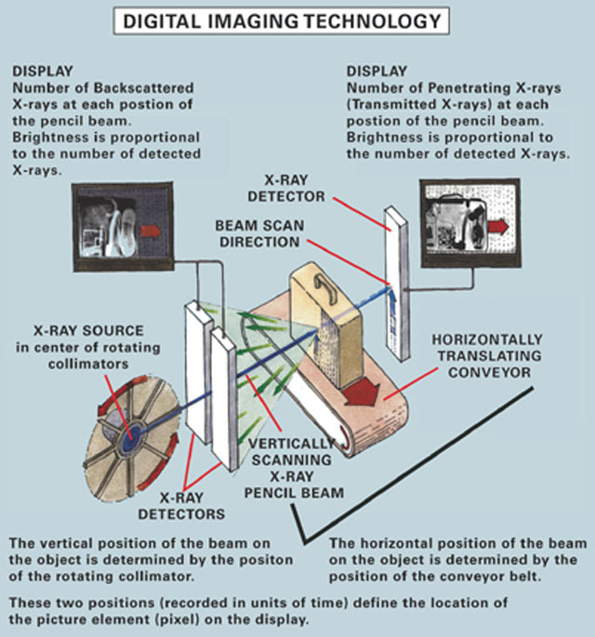
Backscatter Scanners
Origin
Towe & Jacobs, 1981
9/11
Technique
Uses x-rays
Point-source or scanning beam source
Physics
Compton scattering, select large angles
Energy tuned to penetrate clothing, not skin
Dose: equivalent to 2 min high altitude flight (TSA)
Applications
Airport security
Cargo containers, trucks
One side only needed to scan
BACKSCATTER
TRANSMISSION

Slide 24
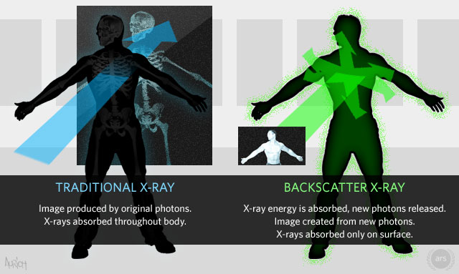
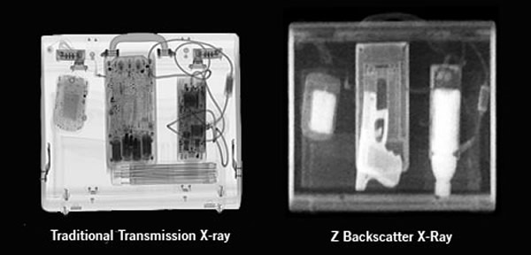
Backscatter vs Transmission

Slide 25
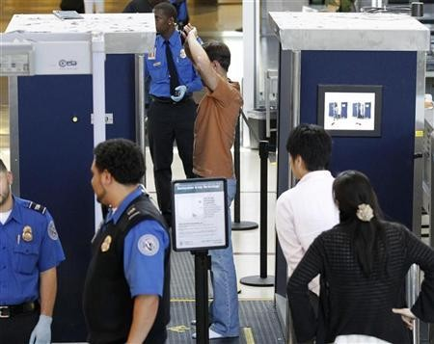
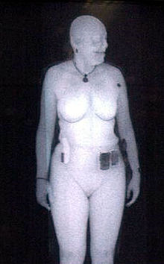
Backscatter Images
Backscatter scanners: two, for front and back images
(also in airports are millimeter wave scanners, which uses EHF RF frequency waves)
Susan Hallowell, Director of TSA’s research lab, c.2011.
Backscattered x-rays are light, while absorbed x-rays are dark

Slide 26
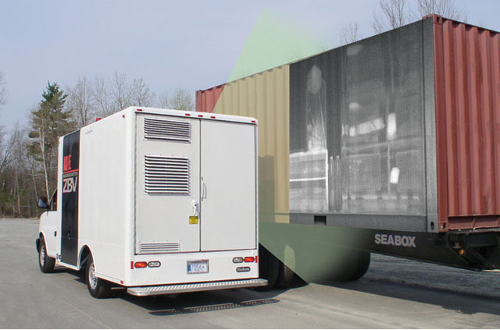
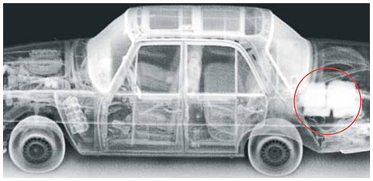
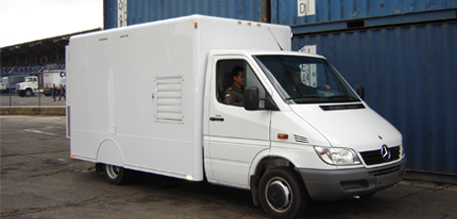
Mobile Backscatter Van
New twist
Package backscatter scanner into a van: ZBVTM
Mobile unit
(not Google Street View)
Still delivers dose

Slide 27
Applications TO ELECTRONICS AND COMPUTING
Part V.
Radiation Damage
Computing Techniques

Slide 28
Radiation Damage to Micro-Electronics
Background
Cosmic ray radiation exists and can damage electronics when passing through silicon
Damage can be serious and can affect operation of:
Satellites … who cares?
Spacecraft … meh?
Airplanes … what?
iPhones … NO!
Enhanced radiation environment at high altitudes is similar to HEP accelerator environment
Effects have small probability, and so depend on the dose rates
MEMORY
4-bit word
0
1
1
0
= 6
cosmic ray
flips a bit…
1
1
1
0
= 14
Effects
Damage usually to digital electronics, so effects are seen in damage to computers
esp. bit flips in memories, called single-event upsets (SEU)
many other effects
Micro-Electronics (chips) can be rad-hard or rad-soft
Need to measure tolerances for rad damage for various components and develop mitigation strategies to avoid big problems
Have measured this ourselves and seen these effects (and others)

Slide 29
Typical Test Setup (SU HEP)
FPGA Board
Aperture
Ø12.7 mm
Ion Chamber
p Beam
Adjustable
mechanics

Slide 30
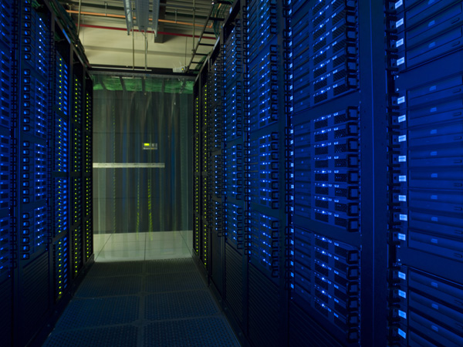
Computing & Networks
World Wide Web
WWW invented at CERN ***
Invented to solve the problem of communicating in an international collaboration of thousands of physicists (for the LHC generation)
Not Internet (DARPA)
Massive data handling
Hardware farms, algorithms for parallel computing
Cloud / Grid computing
Simulation and Analysis Tools
GEANT, EGS, FLUKA large HEP simulation software packages applied to other fields
ROOT interactive statistical analysis tool
Programming and Algorithmic Advances
Neural nets
Decision trees
Principal component analyses
etc. etc. …

Slide 31
Had Enough?

Slide 32
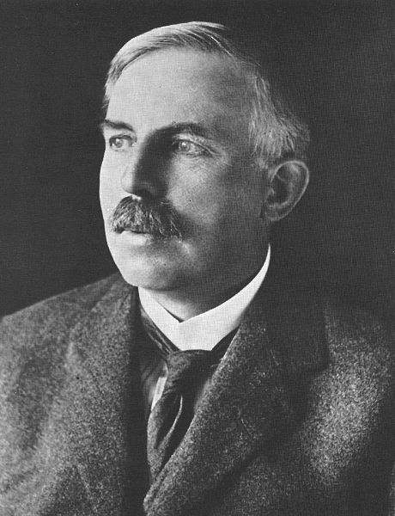
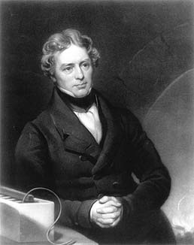
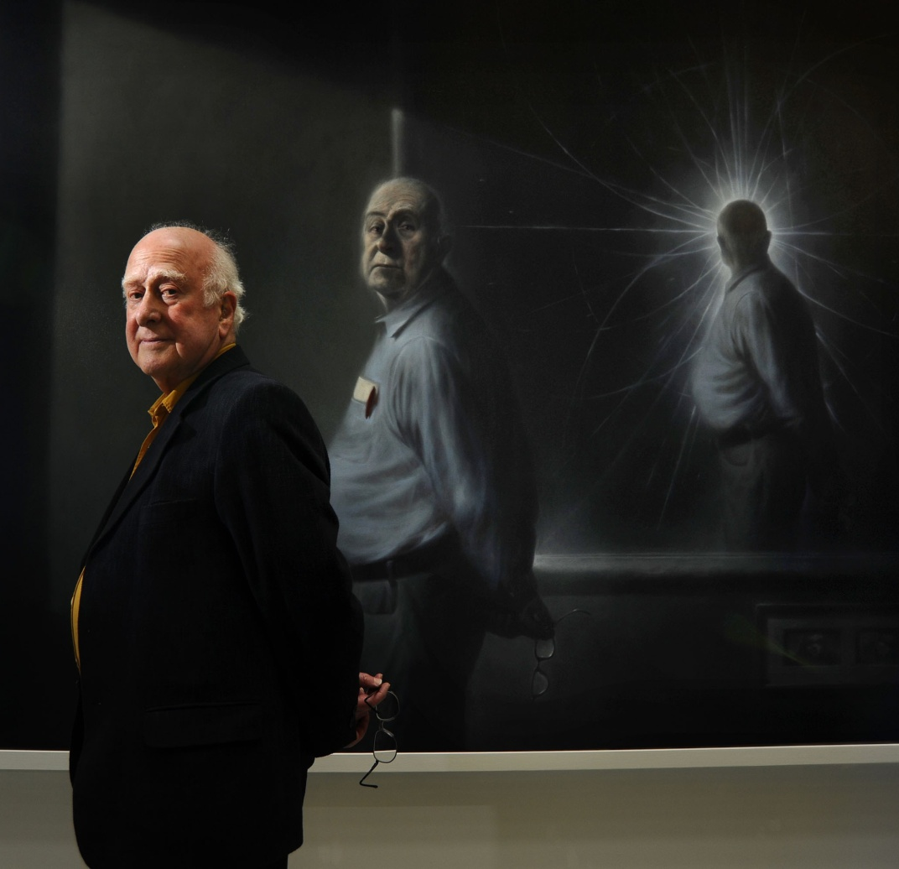
The Future: Are We There Yet?
How will High Energy Physics impact the Future?
Ours is a basic science…
– Faraday, 1840s
– Rutherford, 1911
– Higgs, 2012
What is the use of a small child ?

